Slide 1
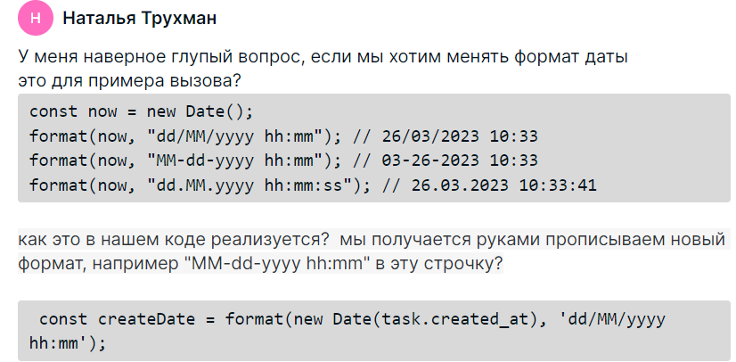

import { format } from "date-fns";

Slide 2
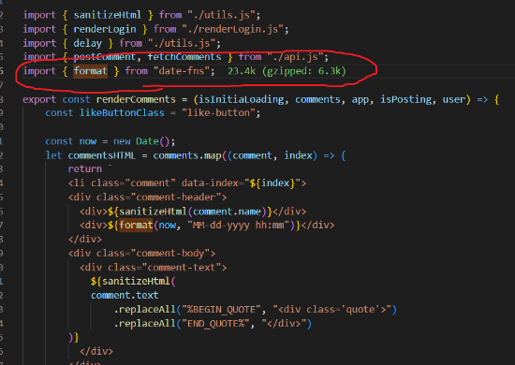

Slide 3

npm run dev

Slide 4
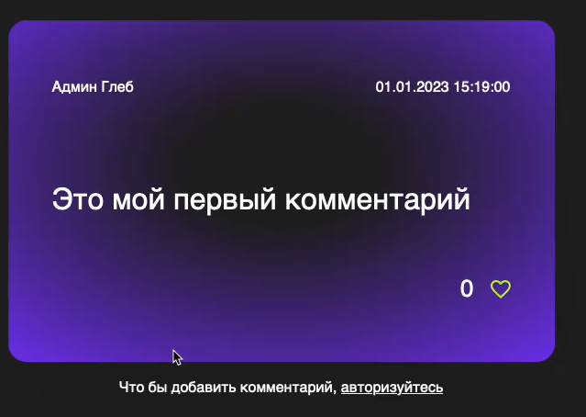

Slide 5
